Slide 1
Learning Objective: To understand how the body controls the level of glucose in the blood.
Homeostasis:
The control of glucose in the blood
IGCSE Biology

Slide 2
Homeostasis
Homeostasis is the maintenance of a constant internal environment.
It includes control of:
water and salts balance – by the kidneys
removal of CO₂ from the blood – by the lungs
control of body temperature
control of blood glucose concentration

Slide 3
Control of Glucose in the Blood
Glucose is needed by cells for respiration.
If the levels of glucose are too low there would not be enough for cells to carry out respiration.
If the levels of glucose are too high, this would affect the water balance (osmosis) of the plasma.
The body controls glucose levels with the help of two hormones that are made in the pancreas.

Slide 4
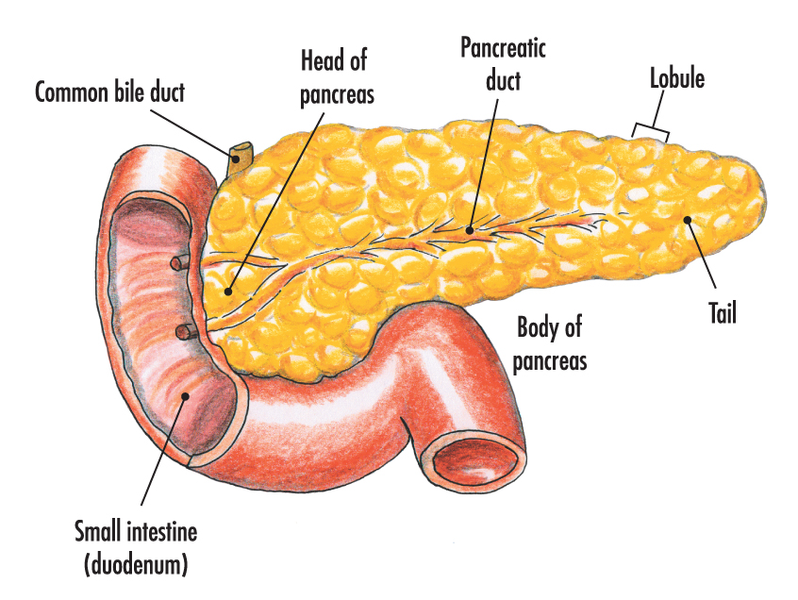
The Pancreas
The pancreas secretes digestive enzymes, which travel down the pancreatic duct into the small intestine.
The pancreas also secretes two hormones directly into the blood – from where it can travel round the body.

Slide 5
If the glucose level rises:
The increased level of glucose is detected by cells in the pancreas (islets of Langerhans), which stimulates the production of the hormone insulin.
Insulin travels in the blood to the liver, where glucose is converted into glycogen, which is stored.
This decreases the levels of glucose in the blood.
The level of glucose returns to normal.

Slide 6
If the glucose level falls:
The decreased level of glucose is detected by the cells in the pancreas, which stimulates the production of the hormone glucagon.
Glucagon travels in the blood to the liver, where stored glycogen is broken down to make glucose.
This increases the levels of glucose in the blood.
The level of glucose returns to normal.

Slide 7
After you have a meal …
Glucose concentration increase
Pancreas/ The islets of Langerhans in pancreas detects the change in glucose concentration
Insulin is secreted
Insulin reaches liver, liver takes up more glucose and store them as glycogen
Blood glucose concentration decrease to norm

Slide 8
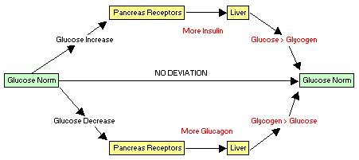
Negative feedback
https://examples.yourdictionary.com/examples-of-negative-feedback.html
Negative feedback: is a type of regulatory mechanism in systems that brings about counteracting/ opposite effects to changes in a system.
Hence, negative feedback promotes/ favours equilibrium, i.e. to stabilize the system.
The thermostat is a prime example of negative feedback.
Notes:
Feedback loops come in two different kinds: positive and negative. Negative feedback loops are more common and work to keep a system stabilized or at equilibrium.

Slide 9
Negative feedback

Slide 10

Steps of Negative Feedback Loops
All negative feedback loops occur in a series of steps. Let's continue to use a thermostat as an example.
You have a stimulus, in which a change occurs. In this case, the temperature in the house increases.
You have a sensor, or the change is detected. In our scenario, the thermostat registers the increase in temperature.
There's a control, which is just a response to the change: the thermostat sends a signal to decrease the temperature.
There's an effector, or the effect of the response. This could be the AC turning on to bring the temperature in the house back down to normal or the heater stopping for a period of time until the temperature is brought back down to normal.
If the temperature were to keep dropping down until it is too cold, then the process would repeat itself, but this time, the response (or control) would be to increase the temperature to bring it back to normal. A negative feedback loop serves to keep a certain variable in check, temperature in this case.

Slide 11
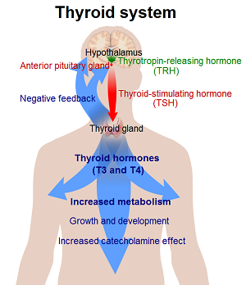
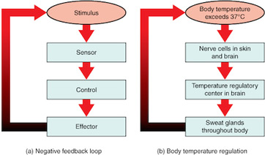
Examples of Negative Feedback Loops
This diagram shows the steps of the negative feedback loop, as well as how it works in temperature regulation.
As you can see, the body exceeds a certain temperature. This is detected by nerve cells that report back to the part of the brain that regulates temperature, and the brain sends out a signal for the body to cool itself down by sweating. Pretty efficient!

Slide 12
Positive feedback
Alarm or panic can spread by positive feedback among a herd of animals to cause a stampede (run in panic).

Slide 13
Positive feedback
Whereas a negative feedback loop causes a decrease in function/ effect, a positive feedback loop will increase a function/ effect. It reinforces the change until a specific outcome is reached. The best way to understand this is through examples.
Childbirth is a positive feedback loop. During childbirth, the uterus will contract until the child is born.
Blood clotting is another example because platelets will continue to be released to the injury site until the bleeding has stopped.
So to simplify, negative feedback promotes equilibrium while positive feedback push a system away from equilibrium.

Slide 14
Type 1 diabetes
Sometimes the pancreas produces small amounts of insulin, or no insulin at all.
This causes the disease diabetes, which can be very dangerous.
If patients cannot control their levels of glucose, they may fall into a coma and could eventually die.

Slide 15
Type 1 diabetes - Symptoms
Symptoms include:
urinating more often than normal
increased thirst
Increased hunger
presence of glucose in urine
extreme tiredness
weight loss
Blurred vision

Slide 16
How is Type 1 diabetes treated?
Patients inject themselves with insulin each day.
They have to control the levels of carbohydrates in their meals (diet restrictions).
They may need to have more, but smaller meals spaced out through the day.
They also need to monitor their blood glucose levels (using glucose meters).

Slide 17


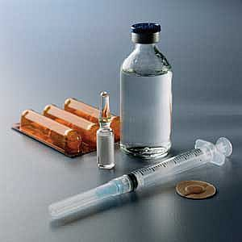
How is Type 1 diabetes treated?

